Slide 1









Tuning Performance of Apache Kafka Rebalance

Slide 2



The Team
Mudambi Seshadri Srinivas
Vaishali Koul
Robert Campbell

Slide 3


Background

Slide 4


Slide 5
Problem Statement

Slide 6

Problem Statement
Consumer Rebalancing
Partition Reassignment strategies
Range Assignment
Round Robin
Sticky Assignment

Slide 7
Architecture

Slide 8
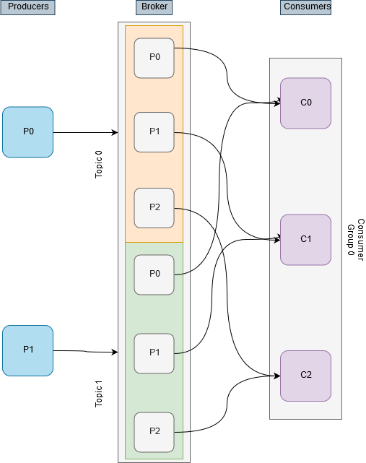
Architecture
3 Consumers, 2 Topics with 2 partitions each.
The general assignment would look something like -
C0 = t0p0, t1p0
C1 = t0p1, t1p1
C2 = t0p2, t1p2

Slide 9
Benchmarking

Slide 10
Range Assignment Strategy
Works on a per topic Basis.
Lays all the partitions in a sequential manner and the consumers in lexicographical order.
Divide the number of partitions with the total number of consumers.
If the division is not even, then the first few consumers will have an extra partition.
C0 = t0p0, t0p1, t1p0, t1p1
C1 = t0p2, t1p2

Slide 11

Round Robin Assignment Strategy
Works on a per topic Basis.
Lays all the partitions in a sequential manner and the consumers in lexicographical order.
Assign from partition to consumer in round robin fashion.
C0 = t0p0, t0p2, t1p1
C1 = t0p1, t1p0, t1p2
.

Slide 12
Sticky Assignment Strategy
Works on a per topic Basis.
Guarantees assignments are balanced as possible while reducing preserving existing assignments.
Reduces overhead from shuffling partitions.

Slide 13
Improvements

Slide 14
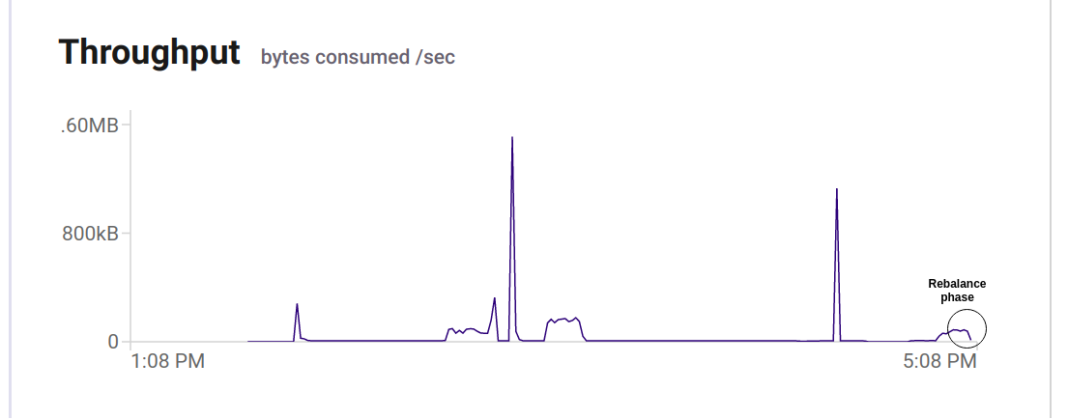
Rou
Round-Robin Assignment RRCSKADK

Slide 15
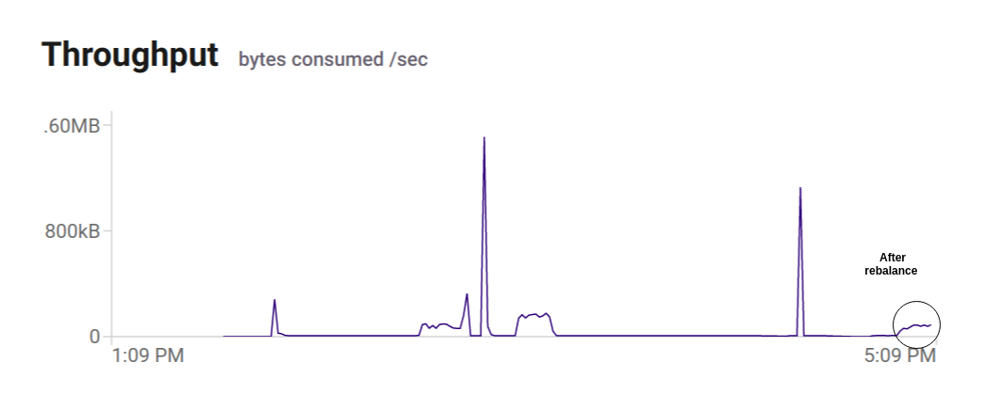
After Rebalance

Slide 16
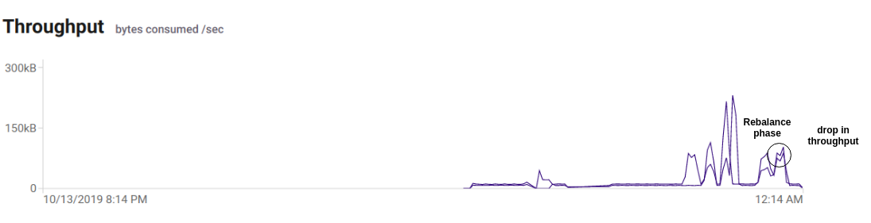
Sticky Assignment

Slide 17
Initial Configuration
t1p0, t1p1, t1p2,
t2p0, t2p1, t2p2.
Each consumer is subscribed to all the topics.
The assignment with both sticky and round-robin
Consumer | Topic - Partition Assignment
Consumer-1 (C0) | t1p0, t2p0
Consumer-2 (C1) | t1p1, t2p1
Consumer-3 (C2) | t1p2, t2p2

Slide 18
Comparing Assignment Strategies
Round robin result :
Changed assignments = 4
Preserved assignments = 2
Consumer | Topic - Partition Assignment
Consumer-1 | t1p0, t1p2, t2p1
Consumer-3 | t1p1, t2p0, t2p2
Sticky assignor result :
Changed assignments = 2
Preserved assignments = 4
Consumer | Topic - Partition Assignment
Consumer-1 | t1p0, t2p0, t1p1
Consumer-3 | t1p2, t2p2, t2p1

Slide 19
Conclusion
Even round robin fails to produce an optimal and balanced assignment to the consumers.
Sticky Assignor reduces the shuffling time by preserving the state before the reassignment.

Slide 20
Future Work
Faster rebalancing using multithreading approach for offset tracking
Improvement in broker assignment strategies

Slide 21


Thanks!
Any questions?

